Slide 1
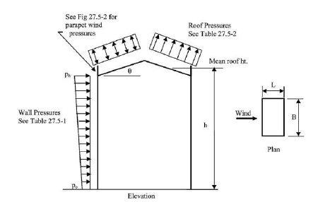
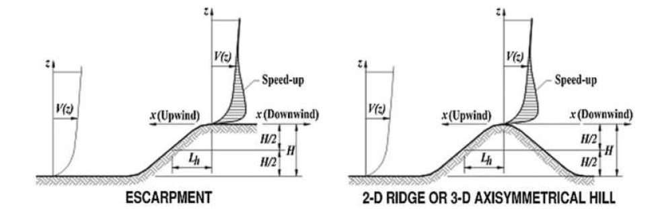
<Basic Input Data>
Exposure Class : Exposure C
Basic Wind Speed : 58 m/s
Building Mean Roof Height : 14 m
Building Dimension normal to wind, B : 15 m
Building Dimension parallel to wind, L : 20 m
Building Type : Open Monoslope
Building Roof Angle : 37 degree
Building Purlin Spacing : 1.2 m
Building Purlin Un-supported Length : 6 m
Should Consider Topographic Feature? no
<Topographic Input Data>
Building Eave Height : 13 m
Distance upwind of crest to where the difference in ground elevation in half the height of hill : 561.454 m
Height of Hill : 280.7 m
Distance from the crest to the building site : 1127 m
Topographic Type : 2Descarpments
<Calculation Basis Information>
Effective Wind Area = 12.0 m^2
Corner Zone Width a = 1.5 m
Fundamental Frequency = 1.0397
Gust-Effect Factor, G = 0.8762
Velocity Pressure Exposure Coefficient KZ = [1.0744]
Topographic Factor, KZT = 1.0
yes

Slide 2
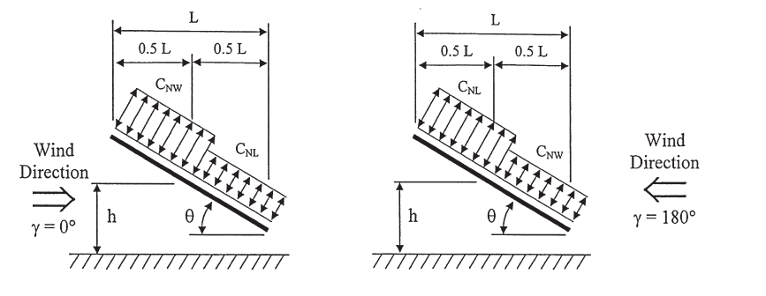
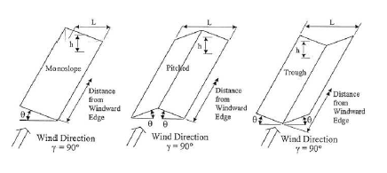
A①
B③
A②
B④
①
②
③
④
<Wind Pressure for Main Structure>
Net Pressure Coefficient, C_NW = [-1.8, 2.1, -2.40667, 2.69333]
Pressure for Main Structural Frame(CW) = [-2970.3, 3465.3, -3971.4, 4444.4] Pa
Net Pressure Coefficient, C_NL = [-1.8, 2.19333, -0.59333, 1.09333]
Pressure for Main Structural Frame(CL) = [-2970.3, 3619.3, -979.1, 1804.2] Pa
Net Pressure Coefficient, CN_gamma90 for <h, <2h, >2h = [-0.8, -0.6, -0.3, 0.8, 0.5, 0.3]
Pressures for Main Structural Frame(gamma90), <h, <2h, >2h = [-1320.1, -990.1, -495.0, 1320.1, 825.1, 495.0] Pa
①
②
③
④
②
①
③

Slide 3
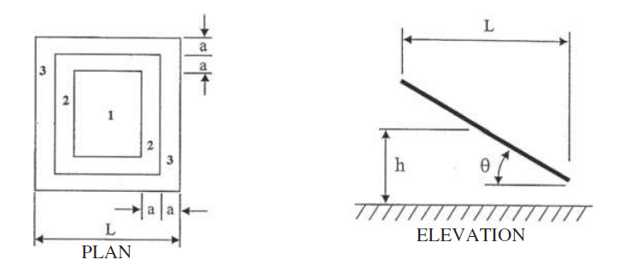
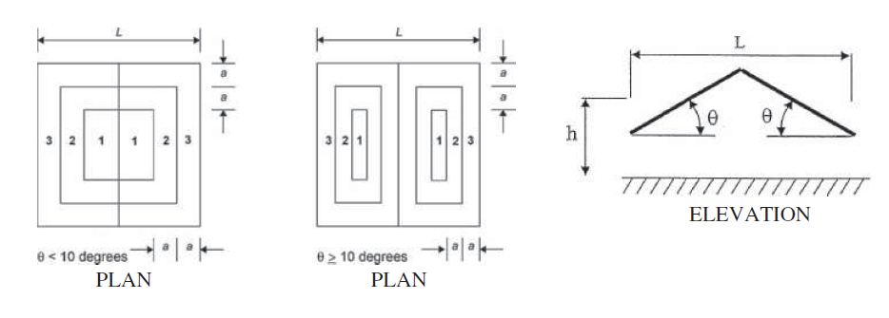
<Wind Pressure for Components and Cladding>
Cladding Zone : 3
CNcc for Loadcase A = 2.6
Pressure for Components & Cladding = 4290.4 Pa
CNcc for Loadcase B = -2.4067
Pressure for Components & Cladding = -3971.4 Pa
Cladding Zone : 2
CNcc for Loadcase A = 2.6
Pressure for Components & Cladding = 4290.4 Pa
CNcc for Loadcase B = -2.4067
Pressure for Components & Cladding = -3971.4 Pa
Cladding Zone : 1
CNcc for Loadcase A = 2.6
Pressure for Components & Cladding = 4290.4 Pa
CNcc for Loadcase B = -2.4067
Pressure for Components & Cladding = -3971.4 Pa

